Slide 1
Credit Card Usage
BY
Alper Tunahan ÖZTÜRK 2290856
Dayanch AKMYRADOV 2347292
Hamza Anıl YILDIRIM 2218386
Kubilay TAŞYÜREK 2218329

Slide 2
Data Description
Continuous variables: Average monthly spend, average monthly balance, average monthly pay rate, grocery spend, travel spend, apparels spend, dining, and entertainment spend.
Discrete variables: times mailed, number of tradelines.
Categorical variables: age groups, income groups, offered annual percentage rate, student loan indicator.
1000 observations,13 variables.

Slide 3
Aim of the Research
Research Question 1 : Which variables are likely to best predict average monthly spend?
Research Question 2 : Does average monthly travel spend differ among age groups?
Research Question 3 : Does the average credit card balance decrease when the annual percentage rate offered is higher?
Research Question 4 : Does average monthly balance significantly differ for student loan indicators or income groups?

Slide 4
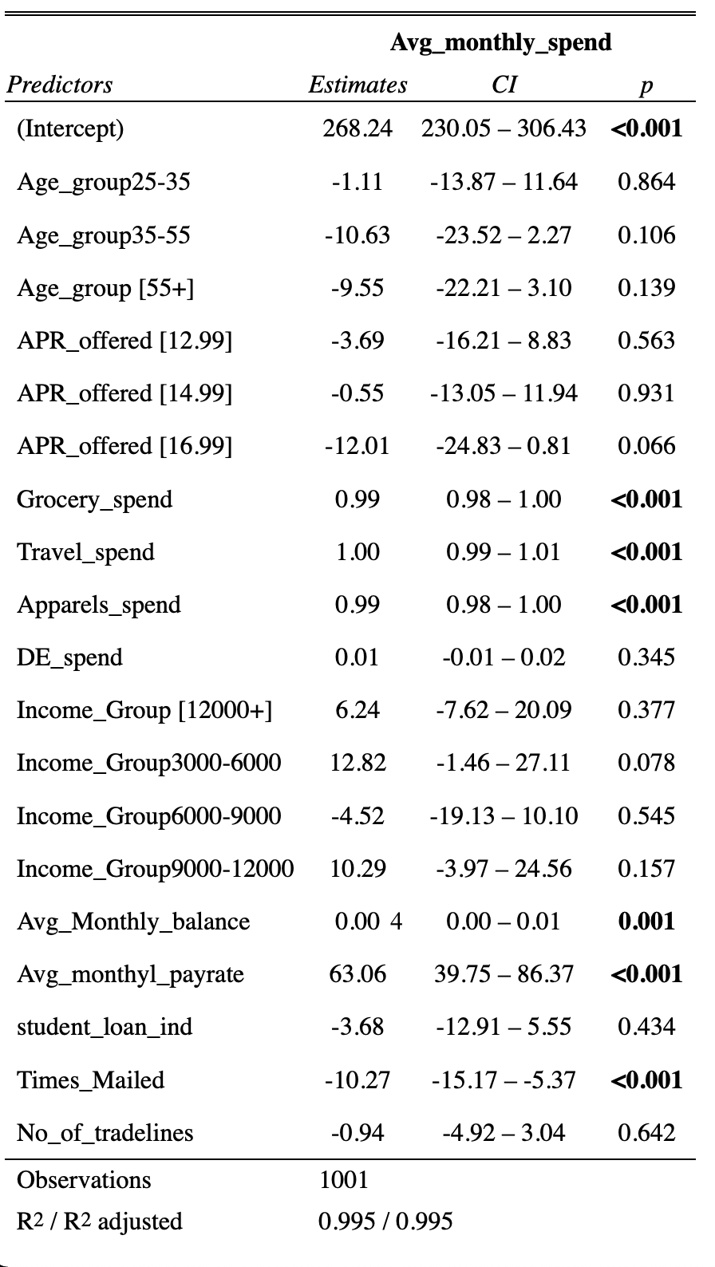
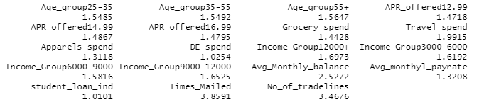
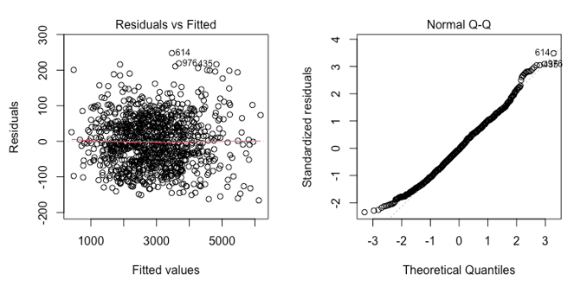
Research Question 1 Which variables are likely to best predict average monthly spend?
Variance inflation factor (VIF) values :

Slide 5
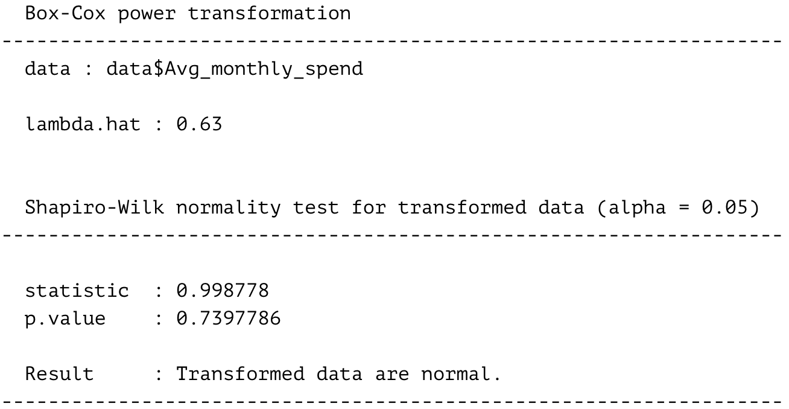
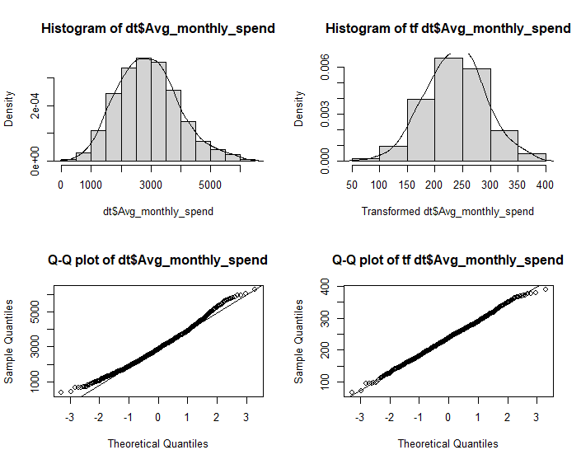
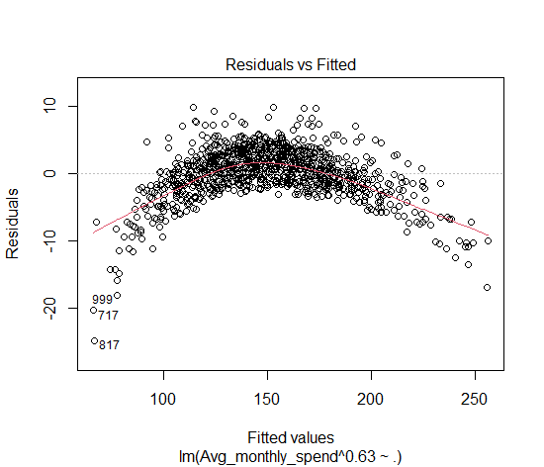
Transformation

Slide 6
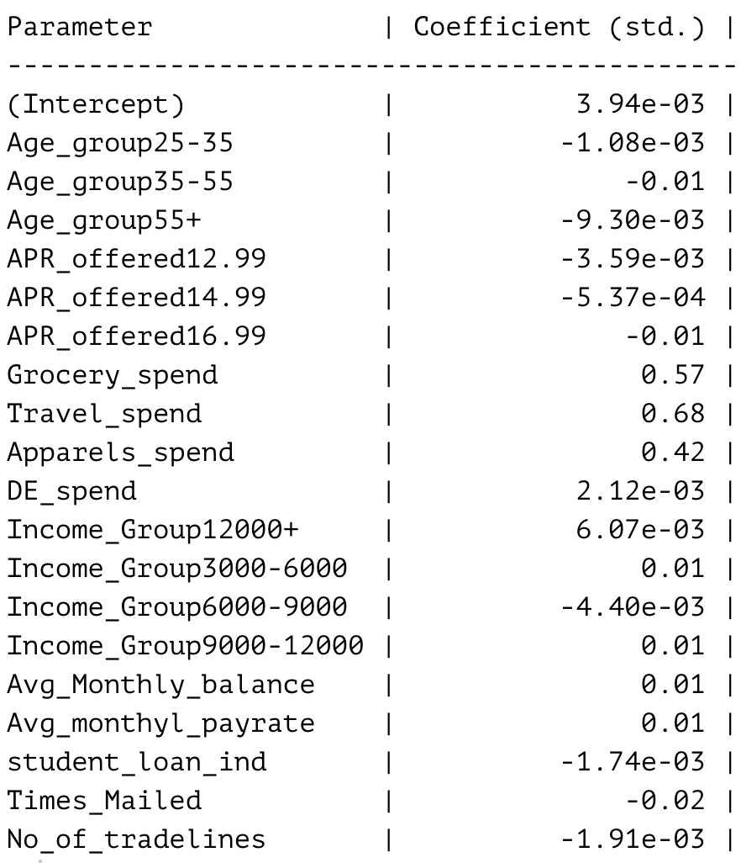
Standardized Model

Slide 7
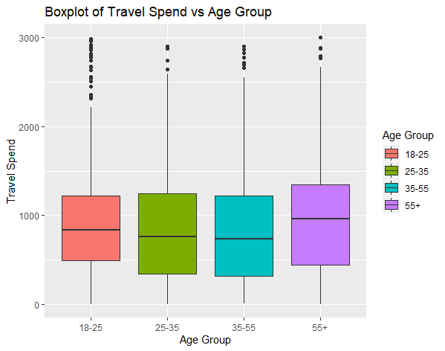
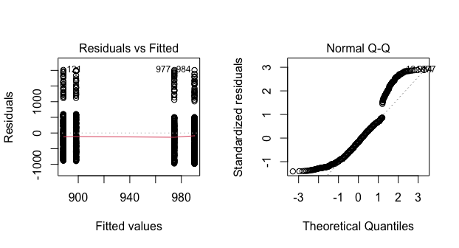
Research Question 2 Does average monthly travel spend differ among age groups?
H₀: Average monthly travel spend does not differ among age groups.
H₁: Average monthly travel spend differs for at least one age group.

Slide 8
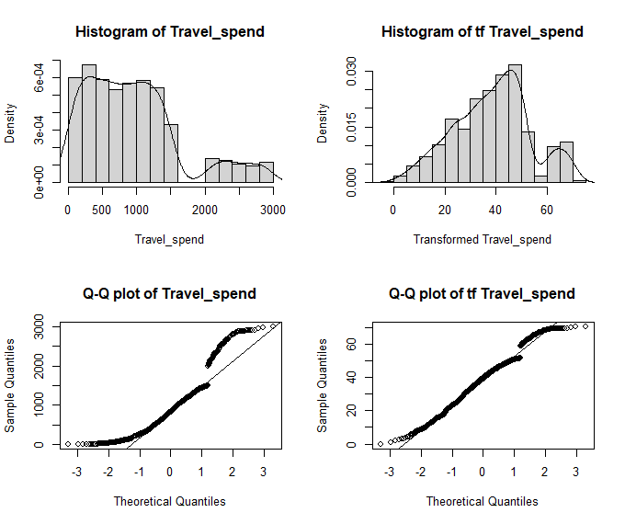
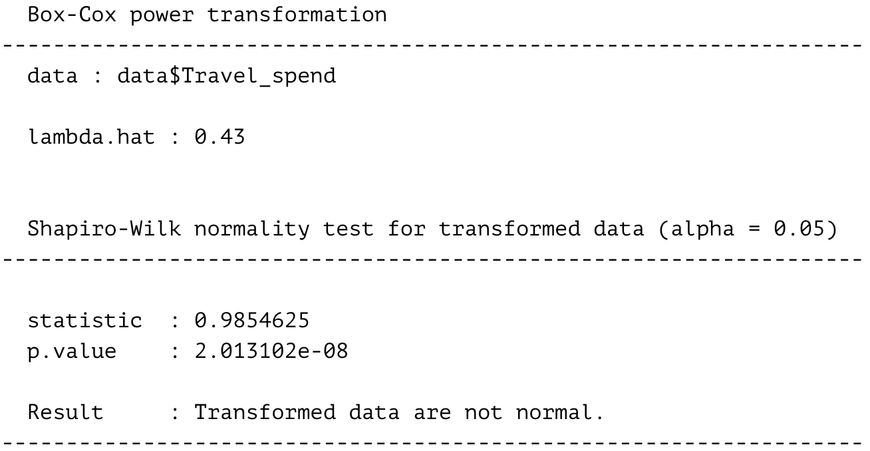

Slide 9
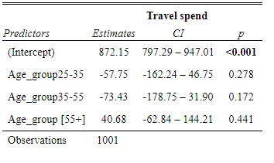
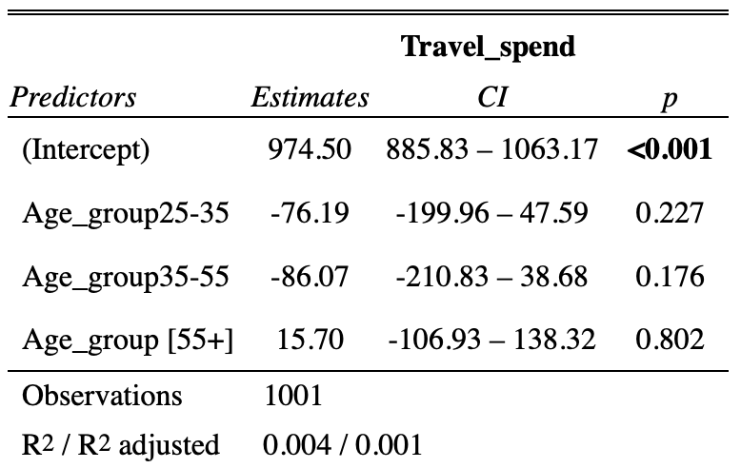
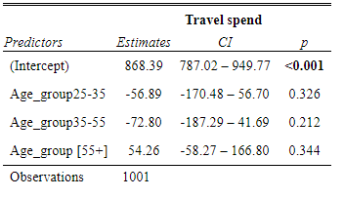
Huber
Model
Bisquare

Slide 10
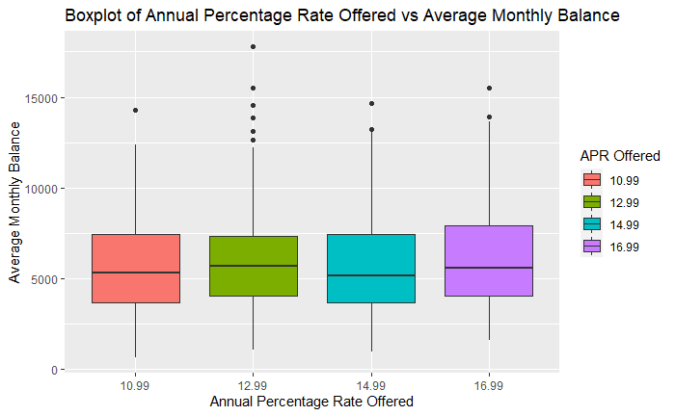
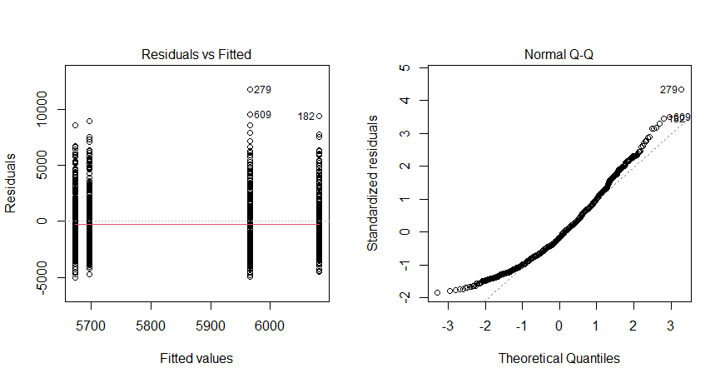
Research Question 3 Does the average credit card balance decrease when the annual percentage rate offered is higher?
H₀: Average credit card balance does not decrease when APR offered increases.
H₁: Average credit card balance decreases when APR offered increases.

Slide 11
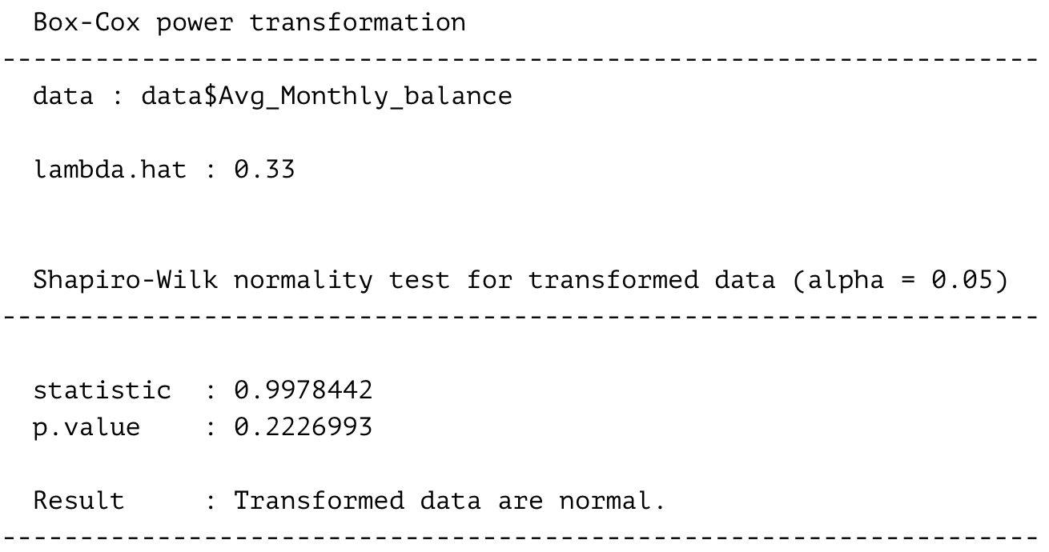
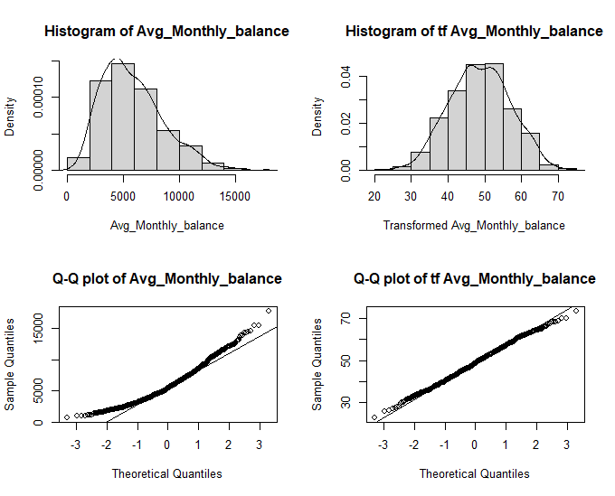

Slide 12
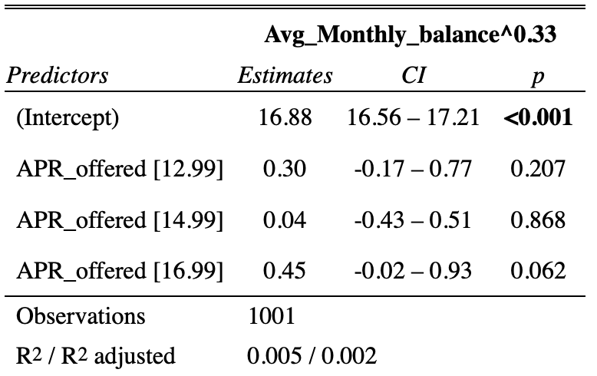
Model on Transformed Data

Slide 13
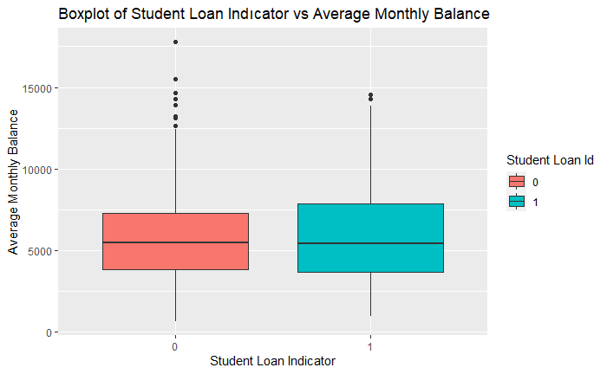
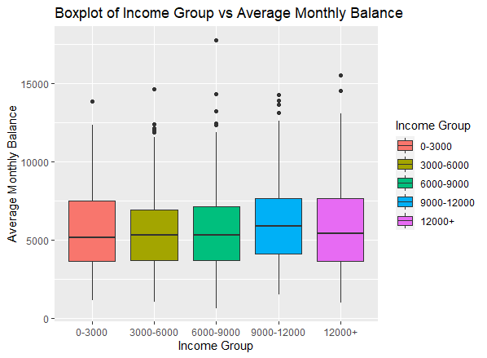
Research Question 4 Does average monthly balance significantly differ for student loan indicators or income groups?
H₀: Average monthly balance does not differ for student loan indicators or income groups.
H₁: Average monthly balance differs for student loan indicators or income groups.

Slide 14
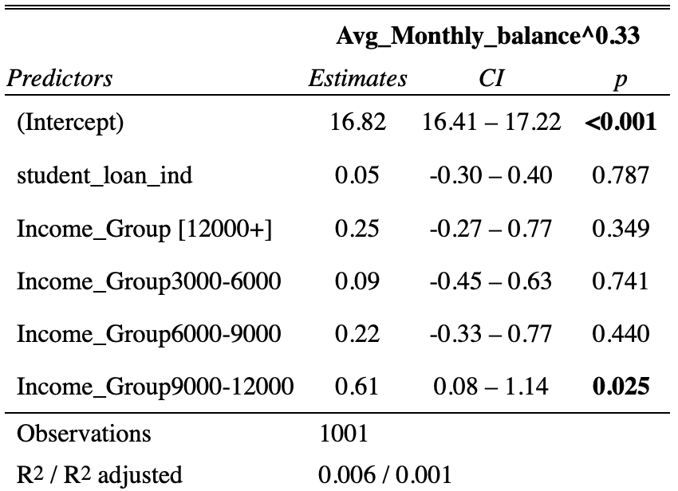
Model

Slide 15
Conclusion

